Slide 1
10.2.6 More Advanced Techniques for Edge Detection
The Marr-Hildreth edge detector

Slide 2
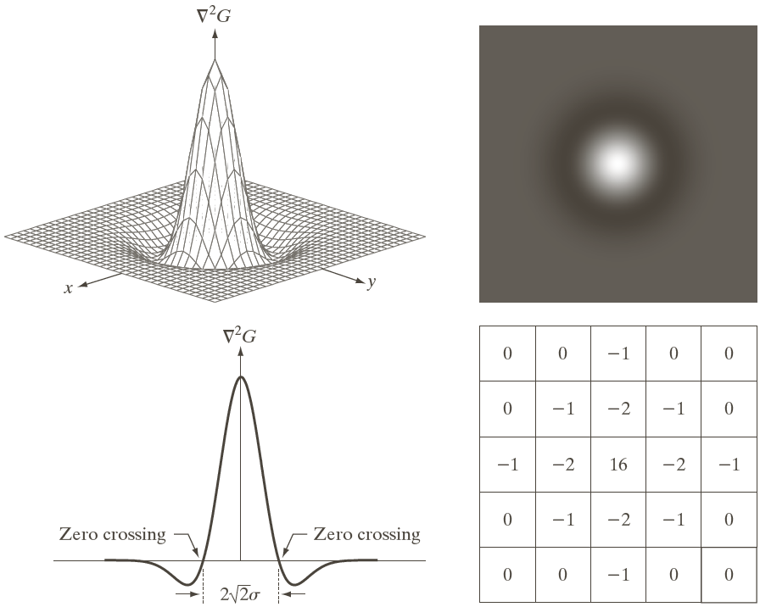
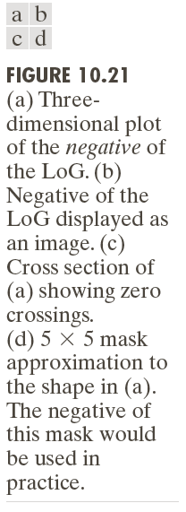
The Marr-Hildreth edge detector

Slide 3
The Marr-Hildreth edge detector

Slide 4
The Marr-Hildreth edge detector
Step 1: filter the input image with Gaussian lowpass filter;
Step 2:Compute the Laplacian of the image resulting from step 1;
Step 3: find the zero crossing of the image from step 2;

Slide 5
Canny edge detector
Step 1:Smooth the input image with a Gaussian filter;
Step 2:Compute the gradient magnitude and angle image;
Step 3:Apply nonmaxima suppression to the gradient magnitude image;
Step 4: use double thresholding and connectivity analysis to detect and link edge;

Slide 6
10.3 Thresholding
10.3.1 Foundation
The basic of intensity thresholding

Slide 7
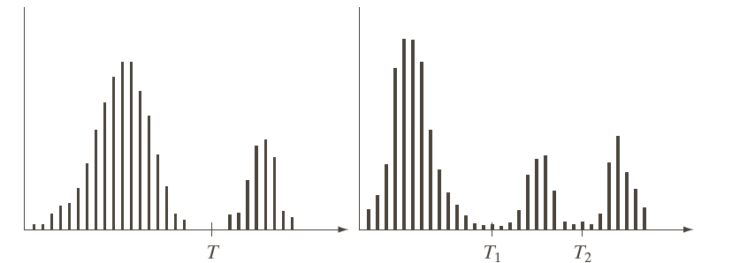
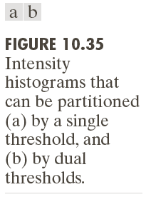
10.3 Thresholding

Slide 8
10.3 Thresholding

Slide 9
10.3 Thresholding

Slide 10
10.3.2 Basic Global Thresholding
Step 1:select an initial estimate for the global threshold, T
Step 2:segment the image using T in 2 Groups:G1={(x,y)|f(x,y)>Thr},G2={(x,y)|f(x,y<=thr)}
Step 3:compute the average intensity values m1 for G1 and m2 for G2
Step 4: compute a new threshold value: T=(m1+m2)/2;
Repeat step 2 to step 4,until T_new –T_old<ΔT

Slide 11
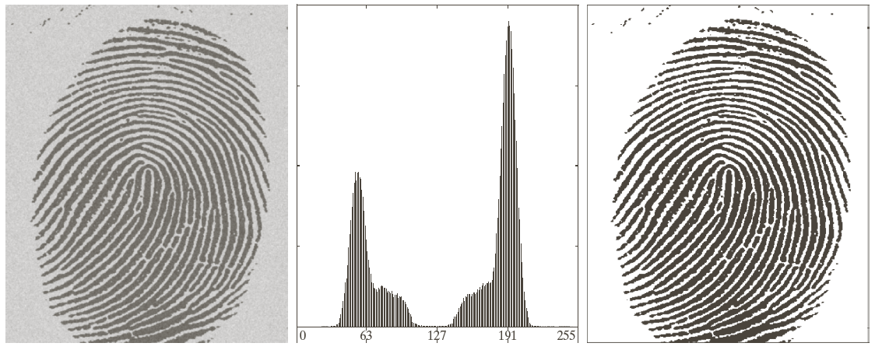
10.3.2 Basic Global Thresholding

Slide 12

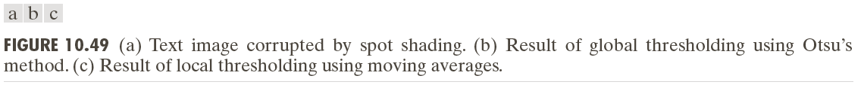
Local Threshoding

Slide 13
Connected-component labeling
Input Output
0 | 0 | 0 | 0 | 0 | 0 | 0 | 0
0 | 0 | ff | 0 | 0 | ff | ff | 0
0 | ff | ff |  | 0 | ff | ff | 0
0 | ff | ff | 0 | 0 | ff | ff | 0
0 | 0 | 0 | 0 | 0 | ff | ff | 0
0 | ff | ff | ff | 0 | ff | ff | 0
0 | ff | ff | 0 | 0 | 0 | ff | 0
0 | 0 | 0 | 0 | 0 | 0 | 0 | 0
0 | 0 | 0 | 0 | 0 | 0 | 0 | 0
0 | 0 | 1 | 0 | 0 | 2 | 2 | 0
0 | 1 | 1 |  | 0 | 2 | 2 | 0
0 | 1 | 1 | 0 | 0 | 2 | 2 | 0
0 | 0 | 0 | 0 | 0 | 2 | 2 | 0
0 | 3 | 3 | 3 | 0 | 2 | 2 | 0
0 | 3 | 3 | 0 | 0 | 0 | 2 | 0
0 | 0 | 0 | 0 | 0 | 0 | 0 | 0

Slide 14
Connected-component labeling
Recursive function
void Label(byte [,] f, int x,int y,byte L)
{
f[x,y] = L;
if (f[x+1,y]==255) Label(f,x+1,y,L);
if (f[x-1,y]==255) Label(f,x-1,y,L);
if (f[x,y+1]==255) Label(f,x,y+1,L);
if (f[x,y-1]==255) Label(f,x,y-1,L);
}

Slide 15
Connected-component labeling
Application
Number of Connected-Components = Lmax-Lmin+1
Separate each Connected-component

